Slide 1
v1.0 Cards-Union
1st Iteration Report
Low Disk Space

Slide 2
0utcomes for 1st Iteration

Slide 3
Primary Web Pages
Elementary Framework
A United Git Repository
Some User Stories
Boot-Strap
Ruby
On Rails
Git

Slide 4
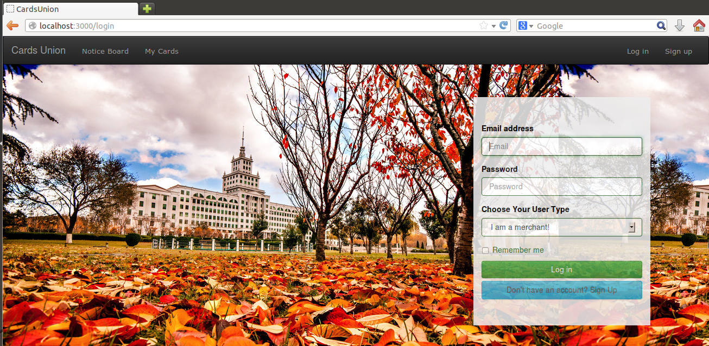
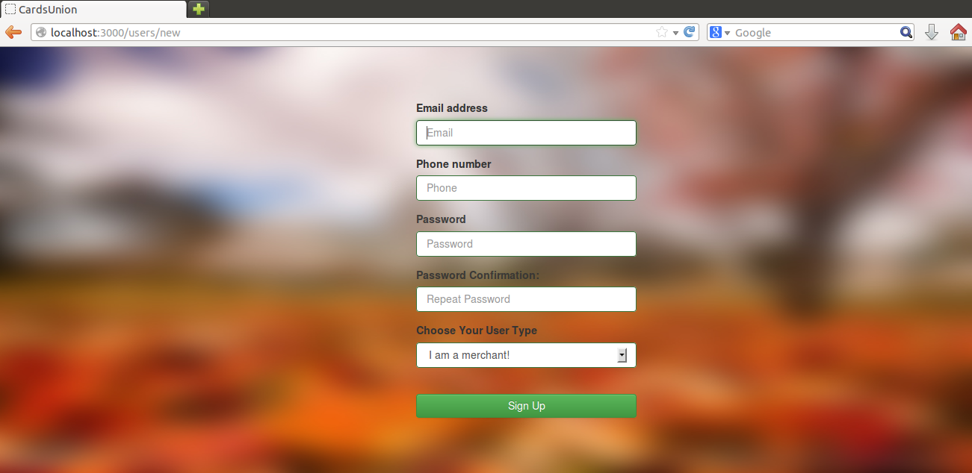
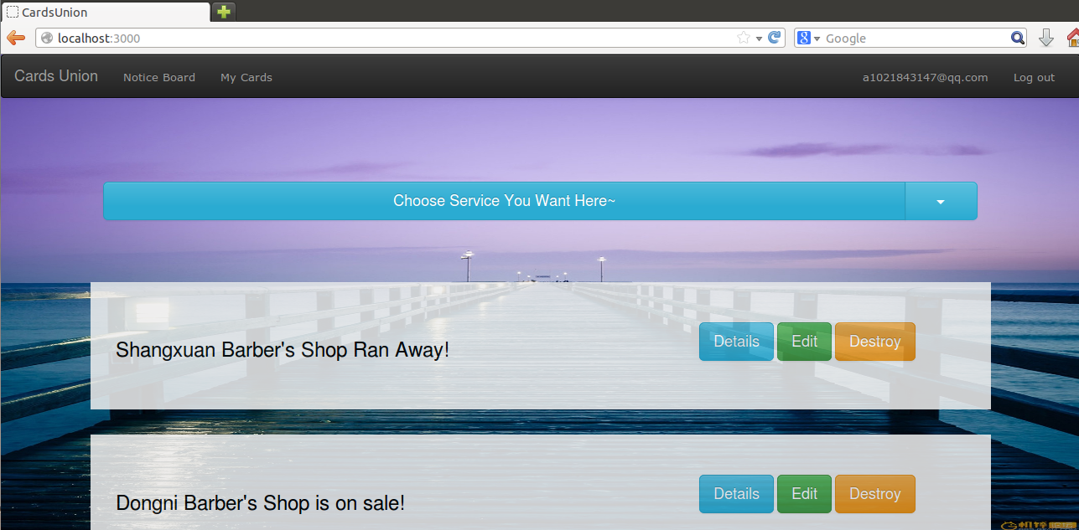
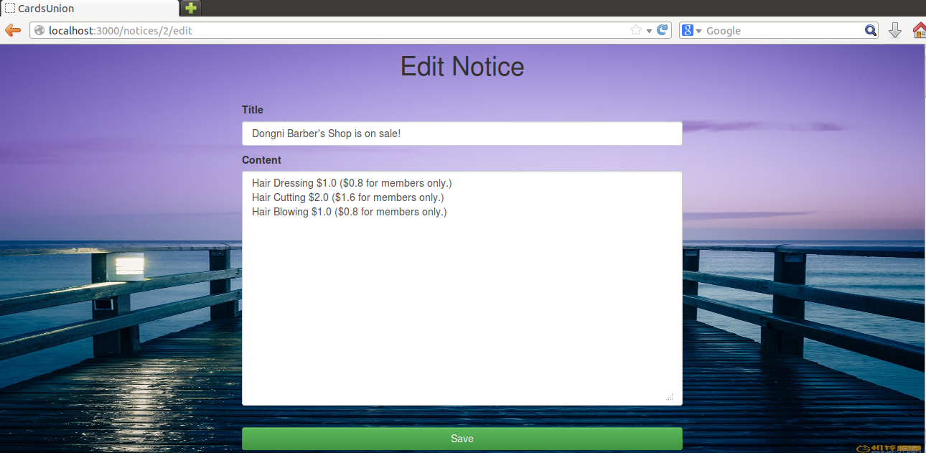
Web
Pages

Slide 5
Rails Framework

Slide 6
John Wang
Cards-Union Git Repository
Bruce Bai
Work
Space
Michael Wu
Frank Yu

Slide 7
30% ( 6/20 )
User Stories

Slide 8
Thanks !

